Slide 1
Leftist heaps

Slide 2
Background
A binary min-heap allows the operations of push and pop to occur in an average case of Θ(1) and Θ(ln(n)) time, respectively
Merging two binary min-heaps, however, is an Θ(n) operation
Are there efficient heap structures that allow merging in Θ(ln(n)) time?

Slide 3
An Idea
A leftist heap is a node-based binary tree
New objects can be placed into a tree at any node which is not full
If we are to merge two heaps, one strategy would be to merge the heap with a sub-tree that has a non-full node close to its root
How do you measure how close a non-full node is to the root?

Slide 4
Minimum null-path length
We will define a null path as any path from the root node to a node that is not full
The length of that path is the null-path length (npl)
The minimum null-path length (min-npl) of a tree is the shortest distance from the root node to a non-full node
Like height,
The min-npl of a single node is 0
The min-npl of an empty tree defined as –1

Slide 5
Minimum null-path length
A few observations:
A binary tree with min-npl of m contains a perfect tree of height m
Therefore, a binary tree with a min-npl of m has at least 2^{m + 1} – 1 nodes
If a binary tree has to sub-trees with min-npls of m₁ and m₂, then the min-npl of the tree is 1 + min(m₁, m₁)
// recursive definition--any real implementation would use
// member variables to store the minimum null-path length
template <typename Type>
int Binary_tree<Type>::min_null_path_length() const {
return empty() ? -1 : 1 + std::min(
left() ->min_null_path_length(),
right()->min_null_path_length()
);
}

Slide 6
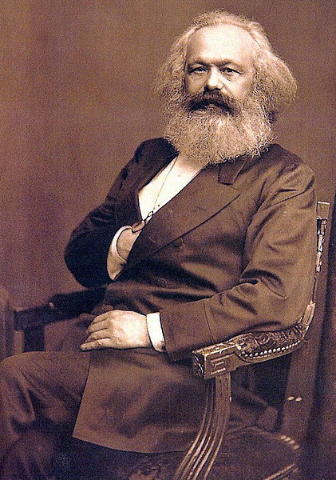
Minimum null-path length
A leftist heap is a heap where the min-npl of the left sub-tree is always greater than or equal to the min-npl of the right sub-tree and both sub-trees are leftist heaps
The term leftist is results from the tree being heavier in the left rather than the right sub-tree

Slide 7
Merging
We will demonstrate an algorithm for merging two leftist heaps
Once we have a merging algorithm, we can implement push and pop in terms of merges:
Push is implemented as merging the leftist heap with a node being inserted treated as a trivial leftist heap
Pop is implemented by removing the root node and then merging the two sub-heaps

Slide 8
Merging
Merging two leftist heaps uses the following rules:
Given two leftist heaps, choose that heap that has the smaller root to be the leftist heap and:
If the right sub-heap is not empty, merge the other heap with the right sub-heap of the selected root
If the right sub-heap is empty, attach the other heap as the right sub-heap of the selected root

Slide 9
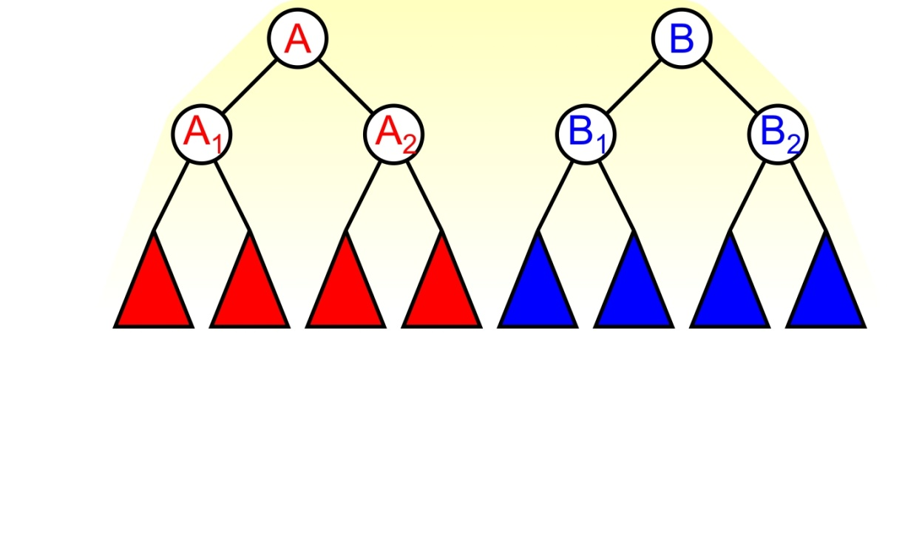
Merging
Suppose we are merging these two leftist heaps:
We compare the roots and note A ≤ B
Therefore, we merge the leftist heap B with the left sub-heap A₂

Slide 10
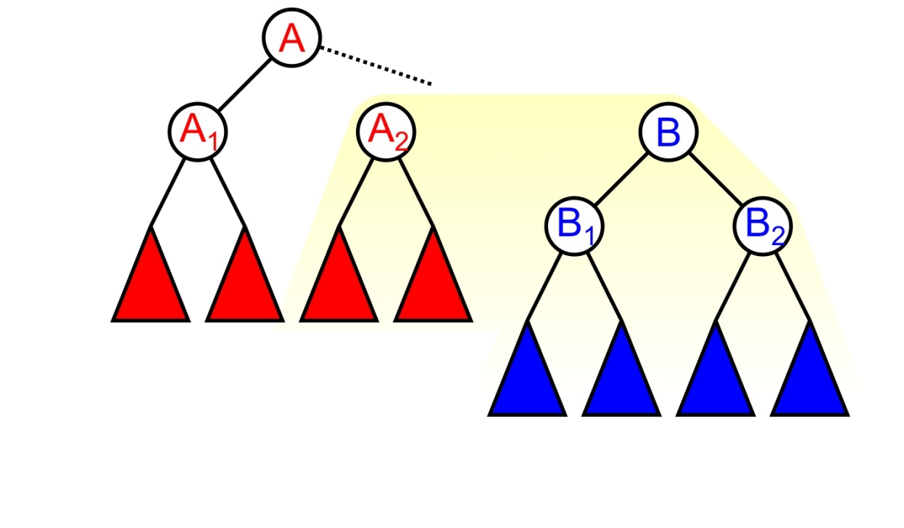
Merging
We will now repeat the merging procedure

Slide 11
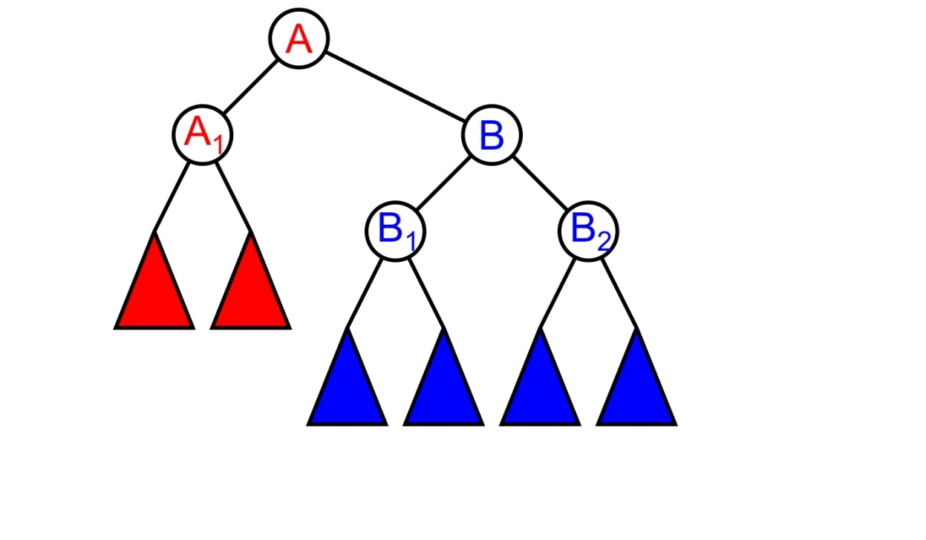
Merging
In the special case that the right sub-heap of A is empty, we attach the leftist heap B as the right sub-heap of A

Slide 12
Merging
If, however, A₂ is not empty, we must merge these two recursively:
Either A₂ ≤ B or A₂ > B

Slide 13
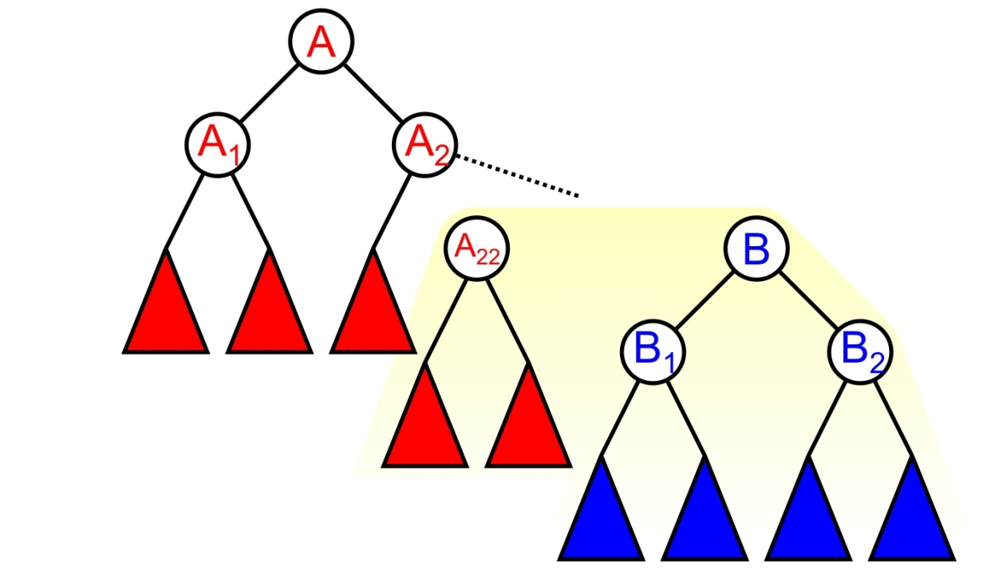
Merging
If A₂ ≤ B, we repeat the process and merge the leftist heap B with the right sub-heap A₂₂

Slide 14
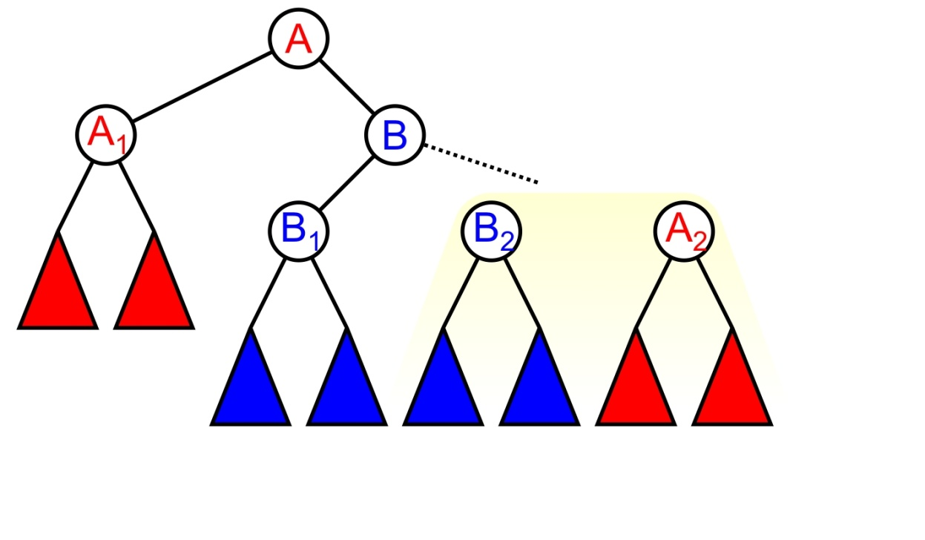
Merging
If B < A₂, B becomes the right sub-heap of A and we now merge the right sub-heap of B with the sub-heap A₂

Slide 15


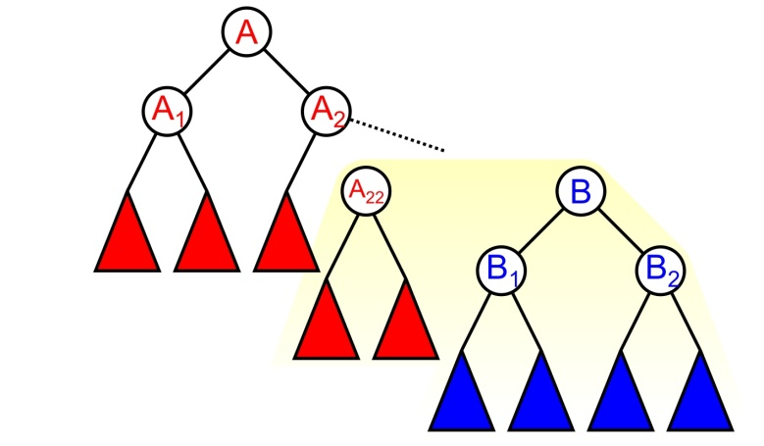

Merging
The three cases for merging heaps A₂ and B
A₂ is empty
A₂ ≤ B
B < A₂

Slide 16
Merging
Implementation:
template <typename Type>
int Binary_tree<Type>::leftist_merge( Binary_tree<Type> *tree,
Binary_tree<Type> *&ptr_to_this ) {
// Perform the merge
if ( empty() ) {
ptr_to_this = tree;
} else if ( retrieve() < tree->retrieve() ) {
right()->leftist_merge( tree, right_tree );
} else {
ptr_to_this = tree;
tree->right()->leftist_merge( this, tree->right_tree );
}
// Corrections to maintain leftist property...
}

Slide 17
Merging
This procedure is repeated until the right sub-heap of tree is empty and the heap being merged is attached
Once we have finished the merging process, we have a heap; however, it may no longer be leftist
As we traverse back to the root, compare the min-npls of the two sub-heaps and swap them if the right min-npl is greater than the left min-npl
Recall that heaps are not ordered trees

Slide 18
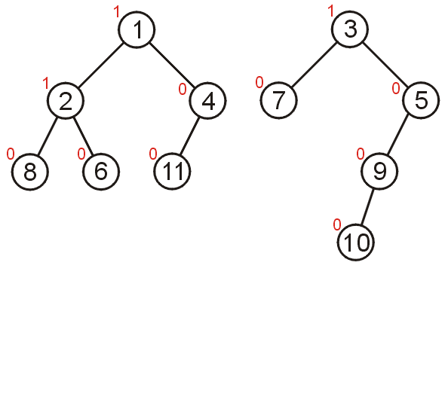
Merging
Consider merging these two leftist heaps

Slide 19
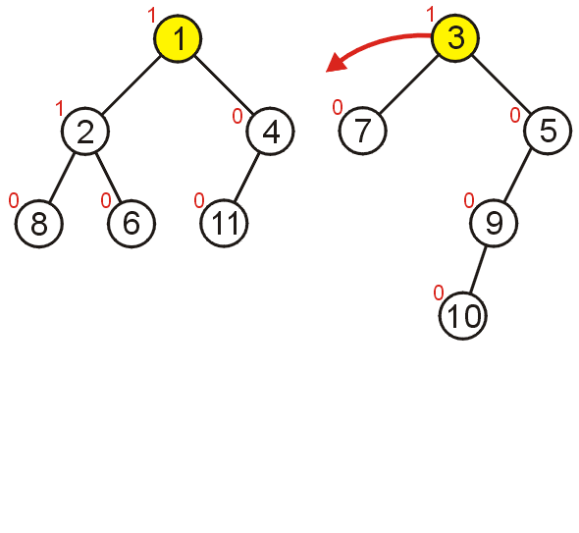
Merging
Comparing the root nodes, 1 < 3 and thus we must merge the first leftist heap with the right sub-heap of the first heap

Slide 20
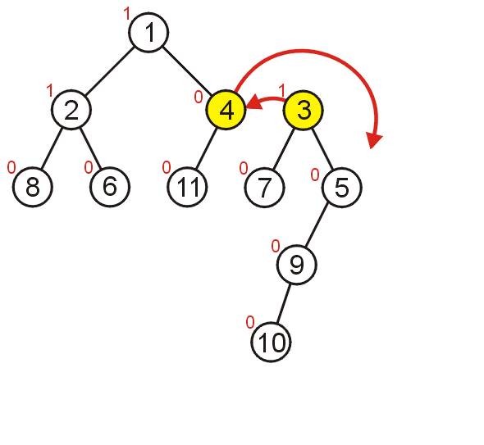
Merging
Comparing 3 and 4, 4 > 3 so we exchange the two heaps and merge the detached sub-heap with the right sub-heap of 3

Slide 21
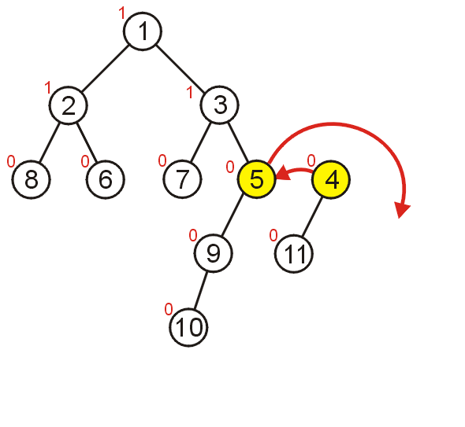
Merging
Comparing 4 and 5, we exchange the two heaps and merge the detached sub-heap with the right sub-heap of 4

Slide 22
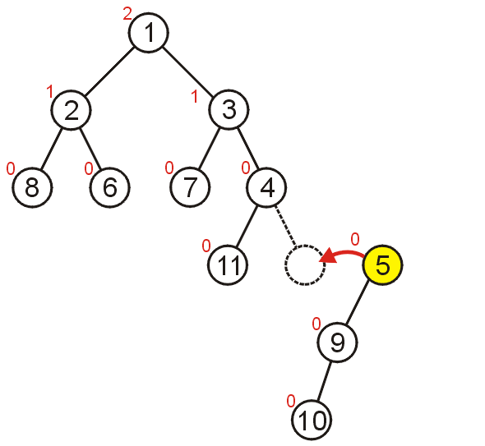
Merging
The right sub-heap of 4 is empty, and therefore we attach the heap with root 5

Slide 23
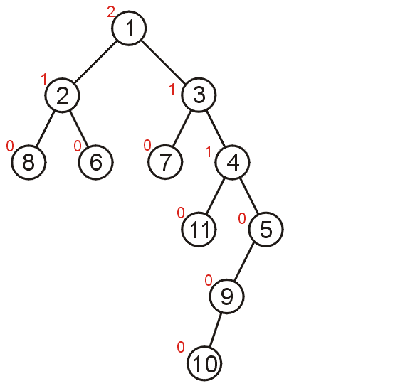
Merging
The heaps are merged, but the result is not a leftist heap
We must recurs to the root and swap sub-heaps where necessary

Slide 24
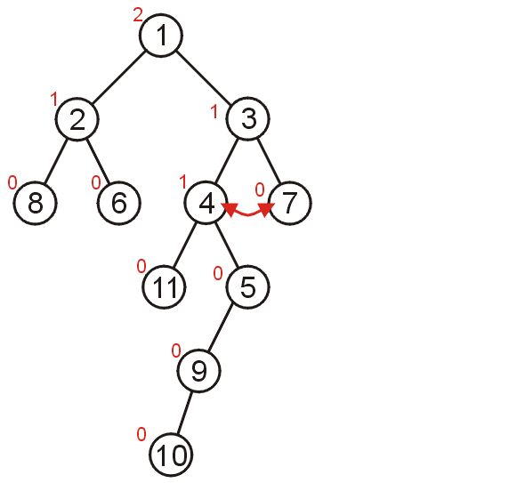
Merging
Node 3 is not a leftist heap and therefore we swap the two nodes

Slide 25
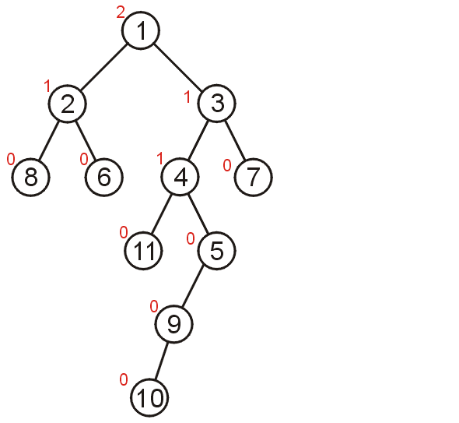
Merging
The root continues to have the leftist property and therefore we have merged the two leftist heaps

Slide 26
Merging
Implementation:
template <typename Type>
int Binary_tree<Type>::leftist_merge( Binary_tree<Type> *tree,
Binary_tree<Type> *&ptr_to_this ) {
// Perform the merge
// Corrections to maintain leftist property
if ( left()->min_null_path_length() < right()->min_null_path_length() ) {
std::swap( left_tree, right_tree );
}
}

Slide 27
Leftist Heaps
Why the leftist property?
The leftist property causes an imbalance towards the left
Insertions and merges are always performed to the right
This results in a balancing effect
A push or insertion is simply the merging of an existing leftist heap and a trivial heap of size 1

Slide 28
Pop
We will demonstrate a pop from a leftist heap

Slide 29
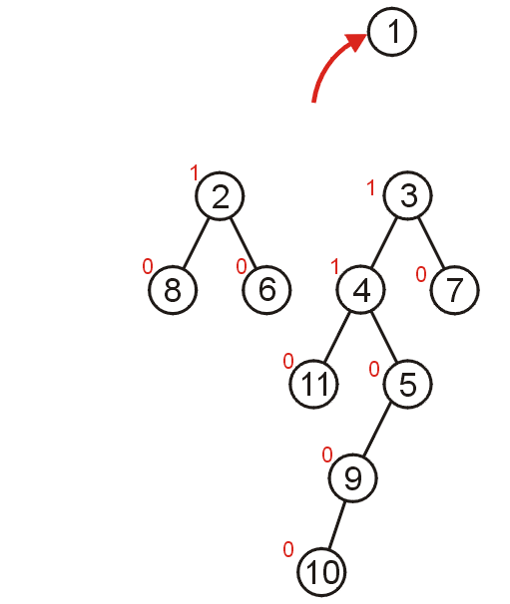
Pop
Removing the minimum node results in two sub-heaps which we must merge

Slide 30
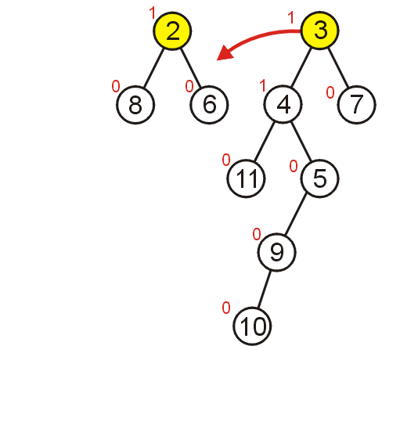
Pop
Comparing the two root nodes, we must merge the 2nd heap with the right sub-heap of the first:

Slide 31
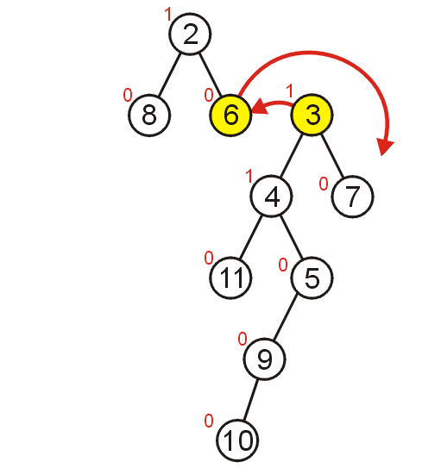
Pop
Comparing 6 and 3, we exchange the two heaps and merge the detached sub-heap with the right sub-heap of 3

Slide 32
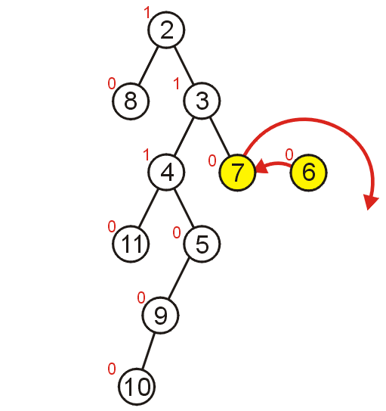
Pop
Comparing 7 and 6, we exchange the two heaps and merge the detached sub-heap with the right sub-heap of 6

Slide 33
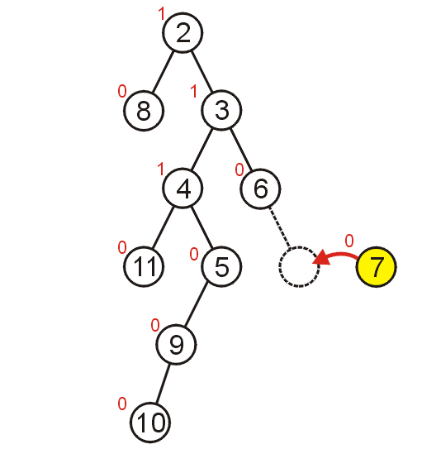
Pop
The right sub-heap of 4 is empty, and therefore we attach the heap with root 5

Slide 34
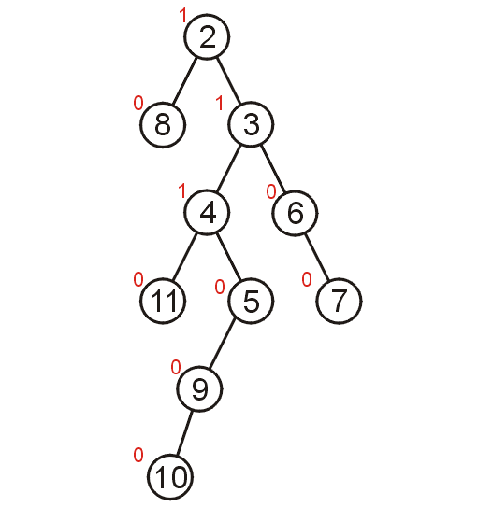
Pop
As before, the heaps are merged, but the result is not a leftist heap
We must recurs back to the root and swap where necessary

Slide 35
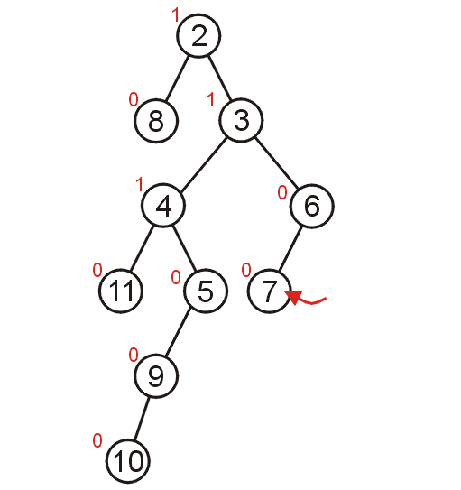
Pop
Node 6 is not a leftist heap and therefore we move the right sub-heap

Slide 36
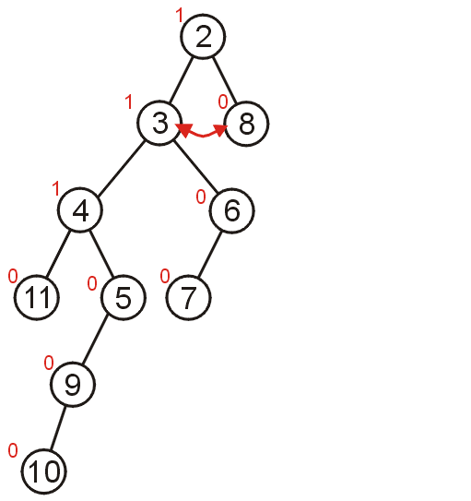
Pop
The root is not a leftist heap and therefore we swap the two sub-heaps

Slide 37
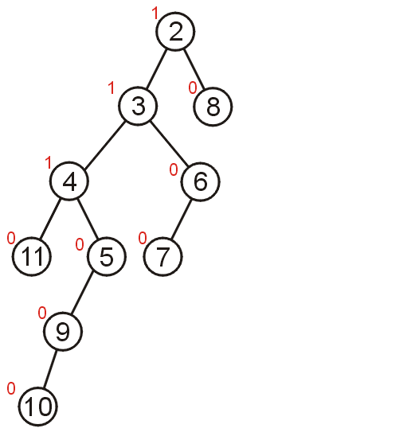
Pop
The result is a leftist heap

Slide 38
Implementation
An implementation of a leftist heap data structure is available at
http://ece.uwaterloo.ca/~dwharder/aads/Algorithms/Leftist_heaps/

Slide 39
Summary
This topic has covered leftist heaps:
Allow an average-time O(ln(n)) merging of two heaps
Unlike a binary min-heap, this uses linked allocation

Slide 40
References
[1] Cormen, Leiserson, and Rivest, Introduction to Algorithms, MIT Press, 1990, §7.1-3, p.152.
[2] Weiss, Data Structures and Algorithm Analysis in C++, 3rd Ed., Addison Wesley, §6.5-6, p.215-25.

Slide 41
Usage Notes
These slides are made publicly available on the web for anyone to use
If you choose to use them, or a part thereof, for a course at another institution, I ask only three things:
that you inform me that you are using the slides,
that you acknowledge my work, and
that you alert me of any mistakes which I made or changes which you make, and allow me the option of incorporating such changes (with an acknowledgment) in my set of slides
Sincerely,
Douglas Wilhelm Harder, MMath
dwharder@alumni.uwaterloo.ca

